Slide 1

Title:
“Movie Recommendation System”
This presentation explores the development of a Movie Recommendation System that utilizes collaborative filtering and genre-based recommendations to personalize movie suggestions for users.
Submitted By: Maryum Qaiser
Roll No:14660
Date: 4th January 2025
GitHub Link:
https://github.com/MARYUMQAISER/Movie-Recommendation-System

Slide 2
Introduction
Objective
Create a recommendation system to suggest movies based on user ratings and genre preferences.
Key Features
Collaborative filtering to find similar users.
Genre-based filtering for personalized recommendations.
Interactive user input for dynamic results.

Slide 3

Tools and Libraries
Programming Language:
Python
Key Libraries
Networkx:
for building and analyzing graphs.
Collections:
for managing data structures like defaultdict.

Slide 4
Data Collection
Graph Construction
Collaborative Filtering
Genre-Based Recommendation
Genre-Based Recommendation
Methodology:

Slide 5



Code Highlights
Key Functions
find_similar_users(): Identify users with similar preferences. recommend_movies(): Suggest movies based on ratings and genre. display_movie_ratings(): Show detailed ratings for selected movies.
Interactive Elements
Input for preferred genres. Recommendations displayed dynamically.

Slide 6
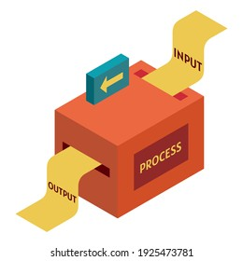
Sample Input and Output:
Input
User ID: "User1" Preferred Genre: "Sci-Fi"
Output
Recommended Movies: _\[Example List\]_ Ratings for selected movies.

Slide 7

Advantages:
Personalized
Tailored movie suggestions based on individual preferences.
Engaging
Engaging user interface for real-time inputs.
Scalable
Scalable with more user data and genres.

Slide 8
Challenges and Future Scope:
Challenges
Future Enhancements
Handling Sparse Data:
When ratings are missing.
Diverse Recommendations
Ensuring recommendations are varied.
External APIs:
Integration with IMDb.
Sentiment Analysis
Adding sentiment analysis from reviews.
Expansion
Expanding genres and user base.

Slide 9
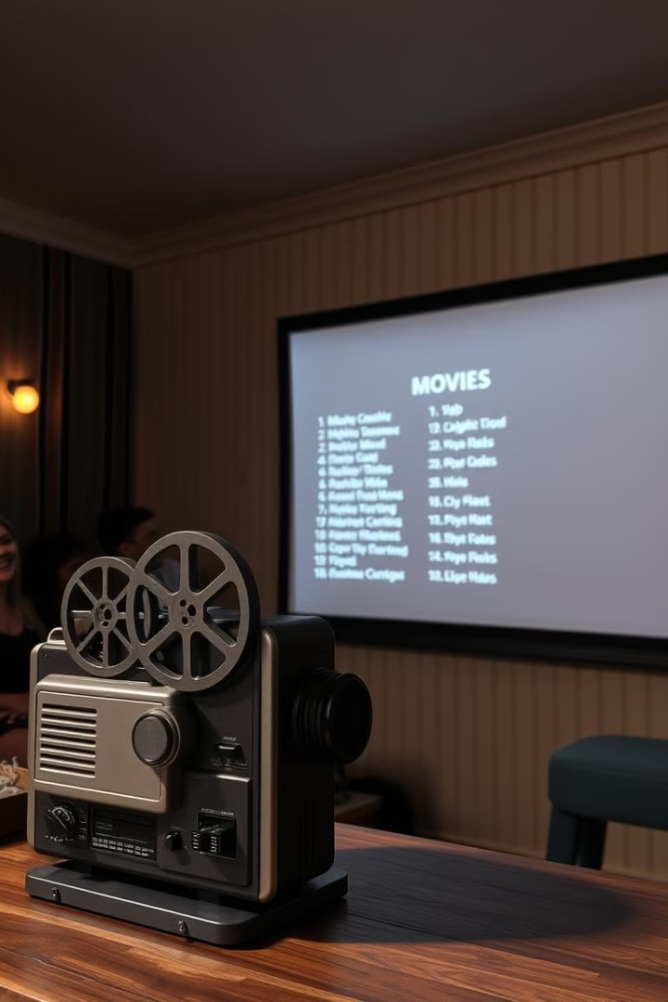
Conclusion:
This project demonstrates a robust movie recommendation system that leverages graph analysis and collaborative filtering. It has the potential to enhance user experience in movie selection by providing personalized and insightful recommendations.

